Slide 1

IST 402 Network Security ECC Elliptical Curve LM6
Joe Oakes
Penn State Abington

Slide 2

TLS Transport Layer Security: Overview
The science of keeping messages secure is called cryptography which involves the encryption and decryption of messages.
In addition to providing confidentiality, cryptography is often required to provide Authentication, Integrity and Non-repudiation (origin of data verified and validated by a third party).
There are two popular kinds of cryptographic protocols: symmetric-key and asymmetric-key protocols.
In symmetric-key protocols (DES, IDEA, & AES) a common key (the secret key) is used by both communicating partners to encrypt and decrypt messages
With symmetric-key cryptosystems provide high-speed key and communication but have the drawback that a common (or session) key must be established for each pair of participants
1976, Diffie and Hellman introduced Public-Key Cryptography. The encoding function here is a trapdoor function-one whose inverse is impractical to implement
The encrypting process (using the Public Key) need not be kept secret.
Pulbic Key cryptographic systems are slower than the symmetric ones
Different Public Key cryptographic systems: RSA, Diffie Hellman (DH) key exchange algorithm, digital signature algorithm (DSA) and ElGamal.

Slide 3
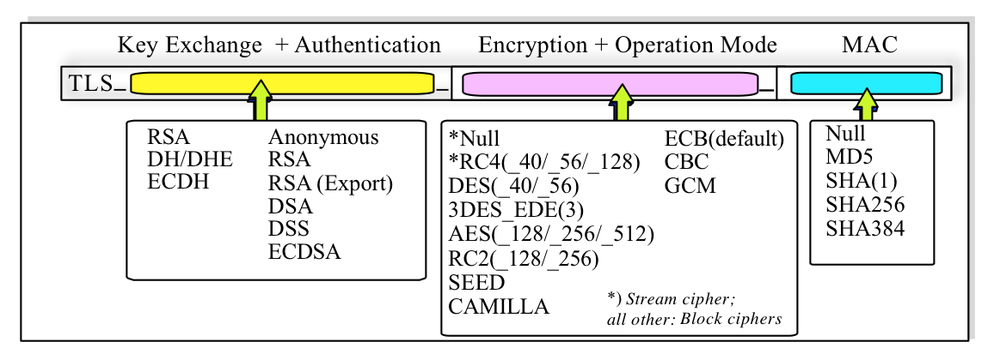
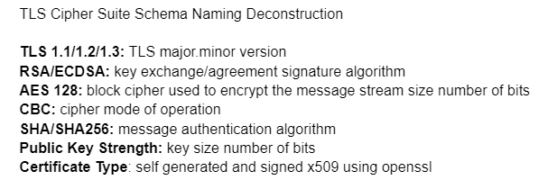
TLS Transport Layer Security: Breakdown of Components
Transport Layer Security methods
Key Exchange
Authentication
Encryption Ciphers
Operation Mode
MAC Hashing check Integrity
Random number generation
Encoding
Certificates
Protocols
Handshaking

Slide 4
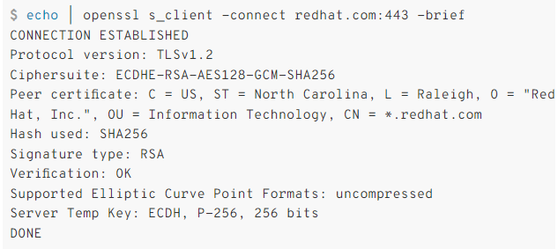
Elliptical Curve: Client -> Server Using OpenSSL
Use the openssl s_client command
You can check the basic validity of a certificate chain sent by a server
Notice you can select the web server Internet address and the port it is listening
Notice you can check the protocol version
You can see the Cipher suite
You can see the certificate
It will show the Hash used
The signature used

Slide 5
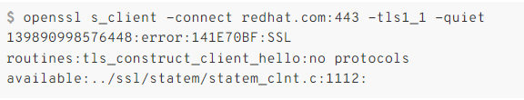
Elliptical Curve: Client -> Server Using OpenSSL
Use the openssl s_client command to specify the version of the TLS protocol used in the connection.
The example shows that TLS 1.1 isn’t supported by the server.

Slide 6
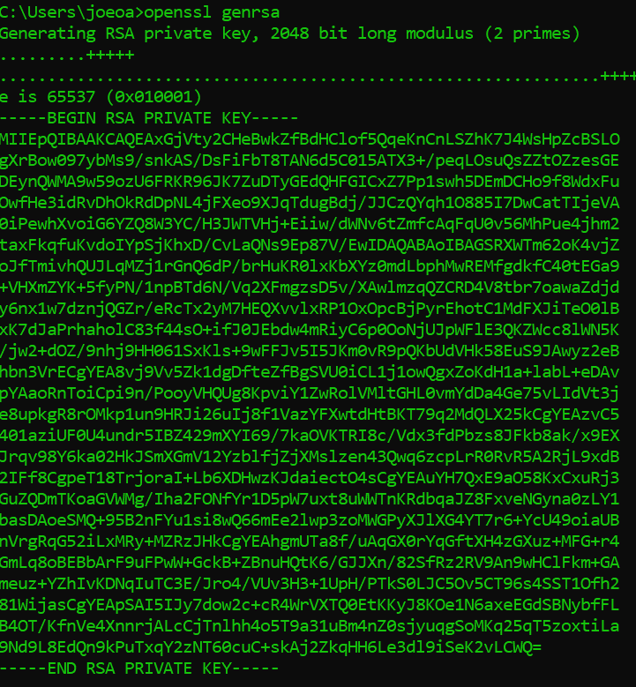
Elliptical Curve: RSA Primes
You can generate 2 prime numbers using openssl
> openssl genrsa
The default size is 2048 bit key

Slide 7
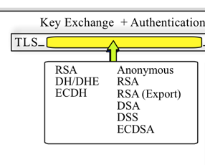
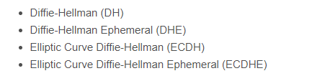
TLS Transport Layer Security: RSA vs DH
Transport Layer Security methods: Authentication
RSA can handle: authentication, Key Generation, Key Exchange, Encryption and Decryption
In RSA the Public/Private key pair is used to both authenticate the server, as well as exchange the symmetric session key. Successfully using the private key to decrypt the pre-master secret IS what authenticates the server.
DH can only handle: key exchange so it must be paired with a digital signature algorithm. With DH + ECDSA/RSA, the asymmetric key pair is only used for the digital signature/authentication portion.
Diffie-Hellman, the Public/Private key pair is NOT used to exchange the symmetric session key. When Diffie-Hellman is involved, the private key is actually associated with the accompanying signature algorithm (ECDSA or RSA)
DH Family

Slide 8
TLS Transport Layer Security: Key Exchange
Transport Layer Security methods
Key Exchange: the key exchange algorithm is used to compute the "master secret" using the "pre-master secret" with the PRF pseudo-random function
Key Exchange Types: RSA, DH, DHE, ECDH, ECDH_ECDSA, ECDHE_ECDSA, ECDH_RSA, ECDHE_RSA
RSA: digital signatures, key exchanges and for encryption purposes
DH: Diffie–Hellman
ECDH: Elliptic curve Diffie–Hellman
ECDSA: is the authentication algorithm (Elliptic Curve Digital Signature Algorithm)
ECDHE_RSA: the server certificate is an RSA certificate (i.e. with long-term RSA keys) but during the TLS handshake it instead agrees a transient/temporary/Ephemeral (the E is DHE) EC public key with DH. So the long term authenticity is confirmed via the server cert's RSA signature but the transient keys are derived via ephemeral EC keys (which then generate the symmetric key)

Slide 9
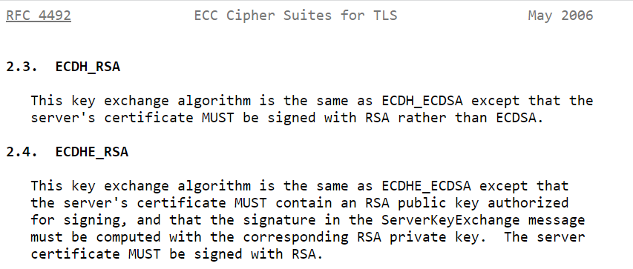
TLS Transport Layer Security: ECDH(E) RSA

Slide 10
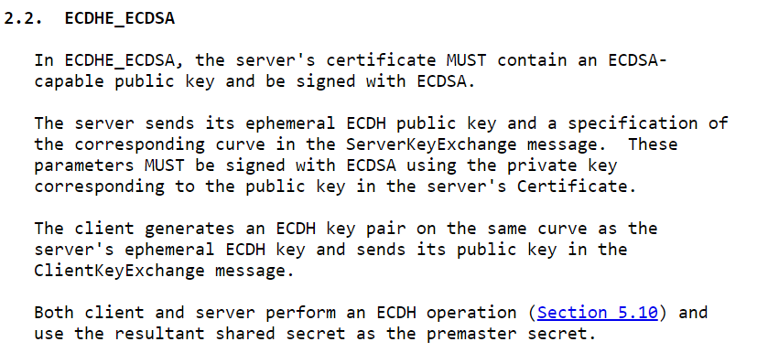
TLS Transport Layer Security: ECDHE_ECDSA

Slide 11
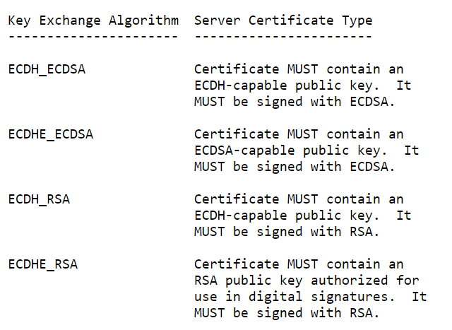
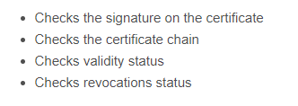
TLS Transport Layer Security: ECDH(E) Key Exchanges
Transport Layer Security: Key Exchanges
ECDH_RSA: Fixed ECDH with RSA-signed certificates
ECDHE_RSA: Ephemeral ECDH with RSA signatures.
ECDHE_RSA: ephemeral (temporary) keys for the Diffie-Hellman process and this provides forward secrecy
ECDHE_RSA: uses RSA to sign the server's ephemeral keys and thus protect the exchange against man-in-the-middle attacks
ECDHE-RSA: uses Diffie-Hellman on an elliptic curve group
Using DH when the client receives the certificate it still runs through the following checks

Slide 12
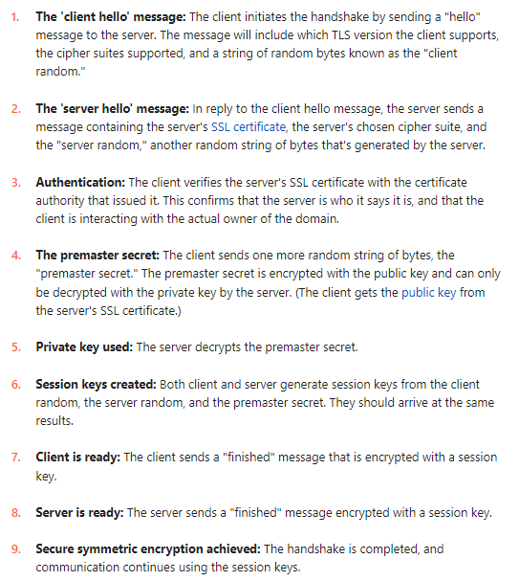
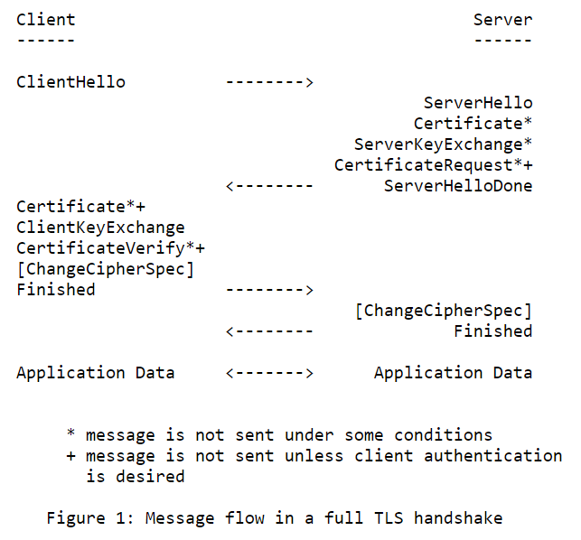
Elliptical Curve: TLS Handshaking: RSA
RSA

Slide 13
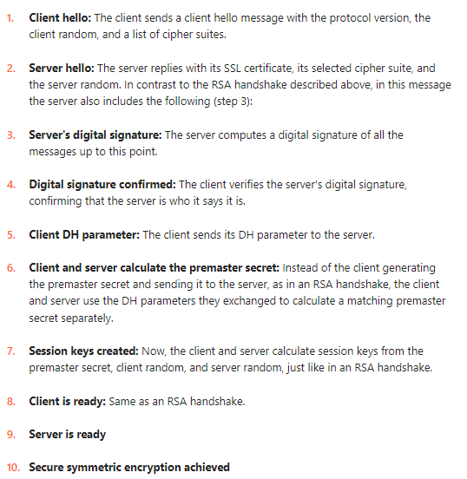
Elliptical Curve: TLS Handshaking: DH
DH
Diffie-Hellman Authentication
The proof of possession check for the private key is different.
During the Server Key Exchange portion of the TLS handshake, the server uses its private key to encrypt the client and server randoms, as well as its Diffie-Hellman parameter.
This functions as the server’s digital signature and the client can use the associated public key to verify that the server is the rightful owner of the key pair.

Slide 14
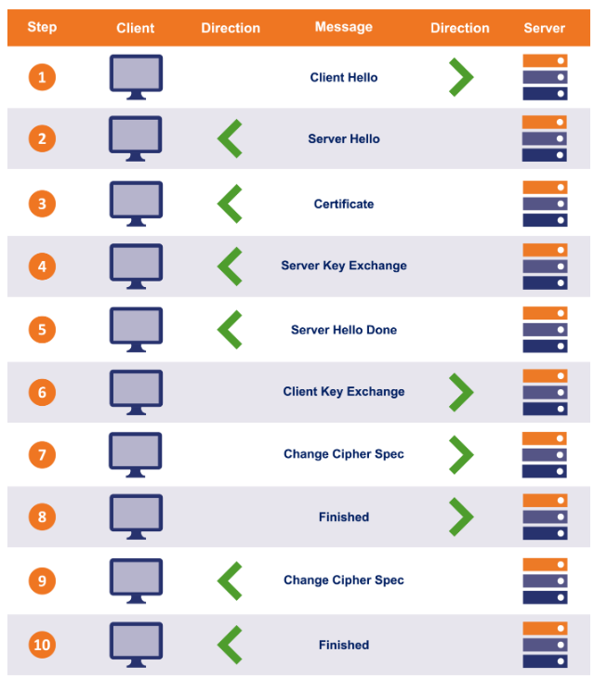
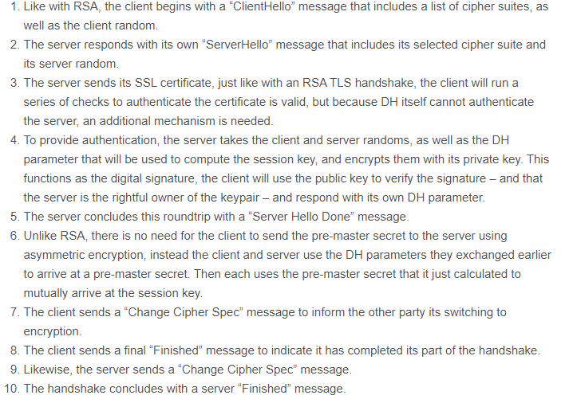
Elliptical Curve: TLS Handshaking: DH
DH

Slide 15
Elliptical Curve: TLS Handshaking: RSA vs DH - Key Exchanges
RSA
DH

Slide 16
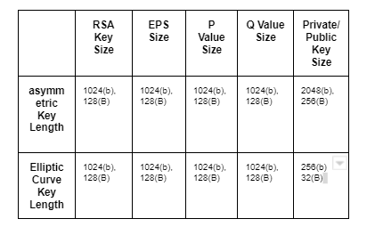
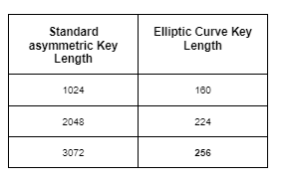
Elliptical Curve: Key Differences
ECC Elliptical Curve Cryptography is a technique based on elliptic curve theory
It can be used to create faster, smaller and more efficient cryptographic keys
ECC is an alternative to the RSA cryptographic algorithm
Encrypted Premaster Secret (EPS)
P and Q values are the prime numbers chosen
Notice the Key length size differences
Asymmetric key 1024 -> EC Key 160

Slide 17
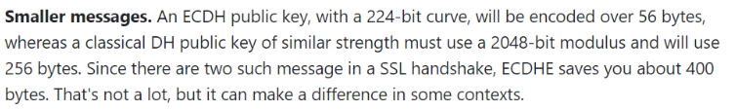
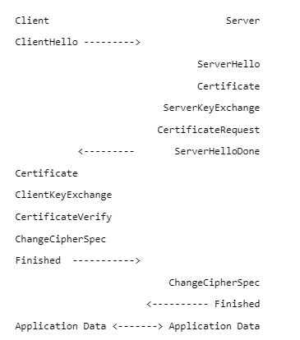
Elliptical Curve: The Curve

Slide 18
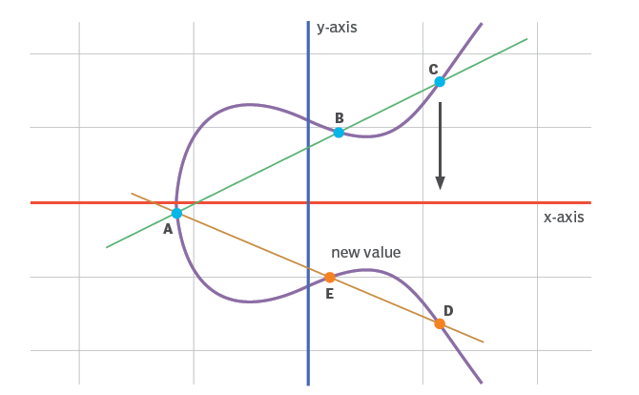
Elliptical Curve: The Curve
Elliptic curves are applicable for key agreement, digital signatures, pseudo-random generators and other tasks
Based on the properties of a set of values for which operations can be performed on any two members of the group to produce a third member
The National Security Agency (NSA) announced Suite B, which exclusively uses ECC for digital signature generation and key exchange.
The NSA allows their use for protecting information classified up to top secret with 384-bit keys which is equivalent to a 7680-bit RSA key

Slide 19
Elliptical Curve: The Curve
ECC Elliptical Curve Cryptography is a technique based on elliptic curve theory
It can be used to create faster, smaller and more efficient cryptographic keys.
ECC 384 key vs RSA 7680 key
ECC is an alternative to the RSA cryptographic algorithm
It is represented as a looping line intersecting two axes
These lines on the graph are used to indicate the position of a point.
The curve is completely symmetric, or mirrored, along the x-axis of the graph

Slide 20
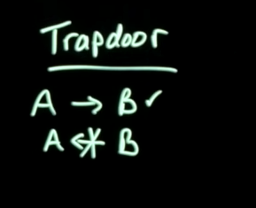
Elliptical Curve: ECC Key Generation
ECC generates keys through the properties of an elliptic curve equation instead of the traditional method of generation as the product of large prime numbers.
The points along the graph can be formulated
y²=x³ + ax + b
Each cryptography mechanism uses the concept of a one-way, or trapdoor, function
Prime A * Prime B = Result value
Result Value / Prime B = cannot get you Prime A
A mathematical equation with a public and private key can be used to easily get from point A to point B
Without the private key getting from B to A is hard if not impossible to achieve

Slide 21
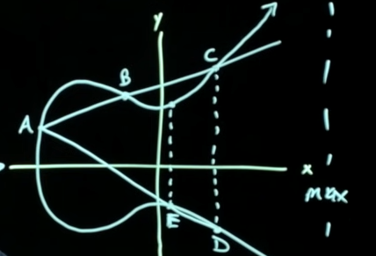
Elliptical Curve: The Curve
A (starting point) dot B yeilds C
Notice drawing a line will intersect the curve at three points – line A, B, C
Because it symmetric you can draw from C down to D
Then you can draw A (starting point) to D
Pick a new point to dot E
You can dot it N number of times you dot out to Z (ending point) value out to a max value X (keep everything within the max value)
The max value X is the key size
N (number of times it is dotted) is the hard number to find which is the private key

Slide 22
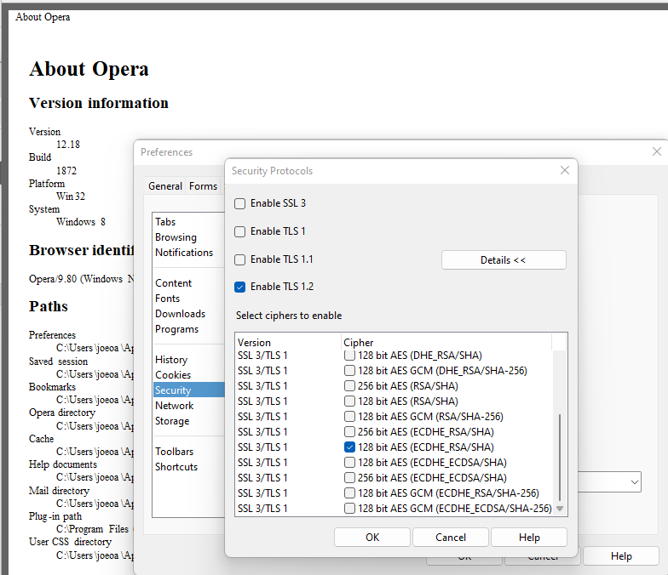
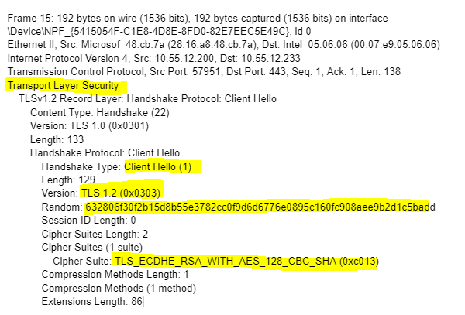
Elliptical Curve: The Client
Using the Opera browser version 12.18 I was able to select the TLS version 1.2
And the Cipher suite it supported
128 AES and ECDHE RSA/SHA

Slide 23
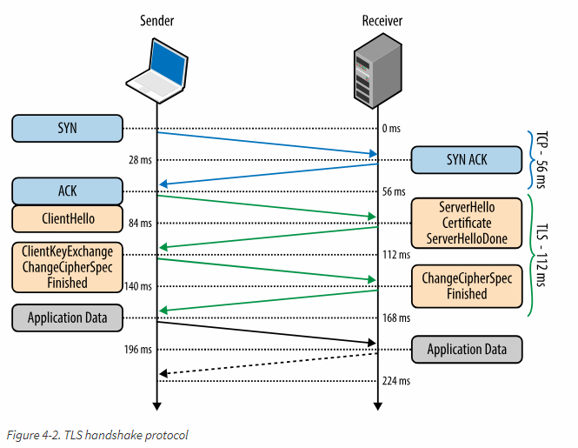
Elliptical Curve: ECDH RSA
Elliptic-curve Diffie–Hellman (ECDH) is a key agreement protocol between two entities, each having an elliptic curve public-private key pair.
These parameters must be signed with RSA using the private key corresponding to the public key in the server's Certificate.

Slide 24
Elliptical Curve: ECDH RSA
DH parameter: DH stands for Diffie-Hellman. The Diffie-Hellman algorithm uses exponential calculations to arrive at the same premaster secret.
The server and client each provide a parameter for the calculation, and when combined they result in a different calculation on each side, with results that are equal.

Slide 25
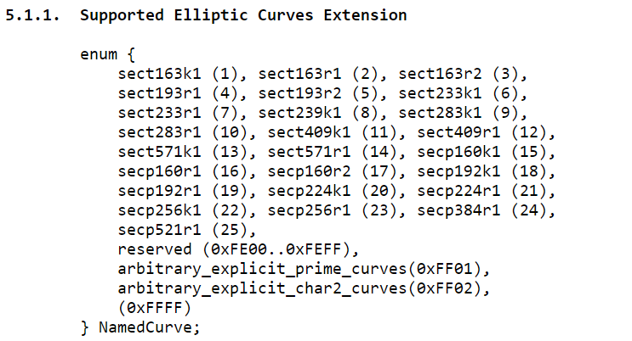
Elliptical Curve: Elliptic Curves Extension
Test

Slide 26
Elliptical Curve: ECDHE RSA
Typical client/server negotiation (SSL handshake) of an ECDH(E) RSA session
The server sends its ephemeral ECDH public key and a specification of the corresponding curve in the ServerKeyExchange message
These parameters must be signed with RSA using the private key corresponding to the public key in the server's Certificate and the RSA server certificate must contain authorized for signing.
The cipher suite ECDHE-RSA-AES128-CBC-SHA
The key exchange will use (ECDHE) and HMAC will use AES128-CBC-SHA.
RSA is used to authenticate the server
ECDHE is used to generate a shared secret between the client and server. server signs with its RSA private key the ephemeral ECDH parameters (public key) it sends to the client.

Slide 27
DES: Works Cited
https://www.techtarget.com/searchsecurity/definition/elliptical-curve-cryptography
https://en.wikipedia.org/wiki/Trapdoor_function
https://blog.cloudflare.com/a-relatively-easy-to-understand-primer-on-elliptic-curve-cryptography/
https://www.redhat.com/sysadmin/6-openssl-commands
https://en.wikipedia.org/wiki/Elliptic-curve_cryptography
https://www.thesslstore.com/blog/explaining-ssl-handshake/
https://www.youtube.com/watch?v=dCvB-mhkT0w

